Slide 1

Times Series Analysis Case Study
Liv-ex 100 Benchmark Fine Wine
Hadrien Pistre

Slide 2
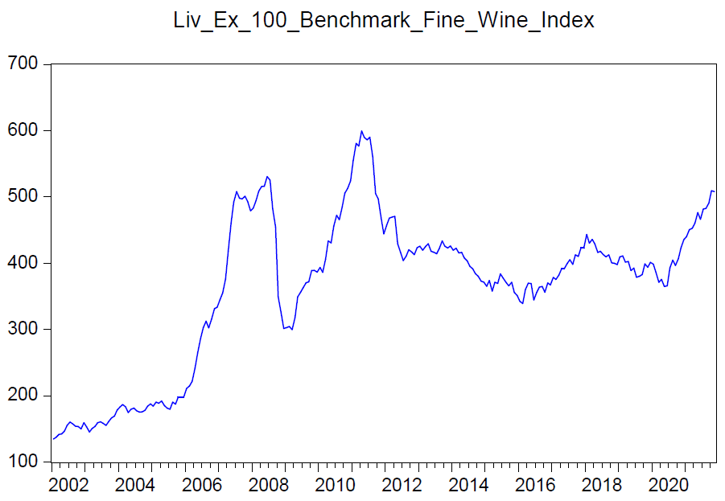

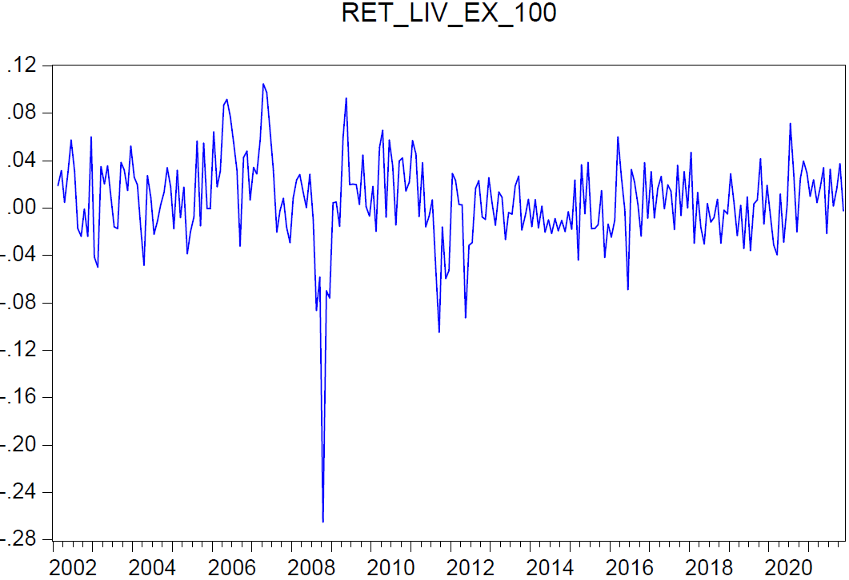
A. Investigation for trends, stationarity, seasonal and intervention effect (1/3)
A
B
• We examine the differences of the Liv Ex 100 (B) to analyse the index’ behaviour and its relationship with other variables. We use the differences to get rid of spurious trends that may yield misleading results.
• We use monthly data for the Liv Ex 100 and all the other variables from Jan. 2002 to Nov. 2022.
Supply factors | Index | Geographical scope
Fertilizers (wineyards) | Fertilizer Prices | North America
Weather in the Bordeaux area | Weather Bordeaux Merignac | France
Brewery equipment | Agricultural & Forestry Machine Index | France
Oak (barrels and corks) | Red Oak Spot Prices | US
Glass (glass bottles) | PPI Manufacture of Glass & Glass Products | France
Conditionning material (cardboard) | PPI Corrugated Cardboard | France
Transportation | CPI Services Related to Transport | France
Energy | CPI Electricity Gas and Other Fuels | France
Demand factors | Index | Geographical scope
Major export markets | Imports from France | China, US, Germany and UK
Domestic market France | France Consumer Staples Index | France
Substitutes factors | Index | Geographical scope
Prices of other wines | CPI Wine from Grapes | France
C
• The Liv-ex 100 Fine Wine Index (A) is computed using bids, offers and transactions of 100 fine wines (mostly Bordeaux) on the Liv-ex’s fine wine trading platform. The index is weighted by a combination of price, production and scarcity. The component wines are reviewed quarterly.
• After a qualitative study, we identified several factors (C) that may influence the Liv-ex 100 Fine Wine Index. We then used indices from Bloomberg that best represent the behaviors of these factors.

Slide 3
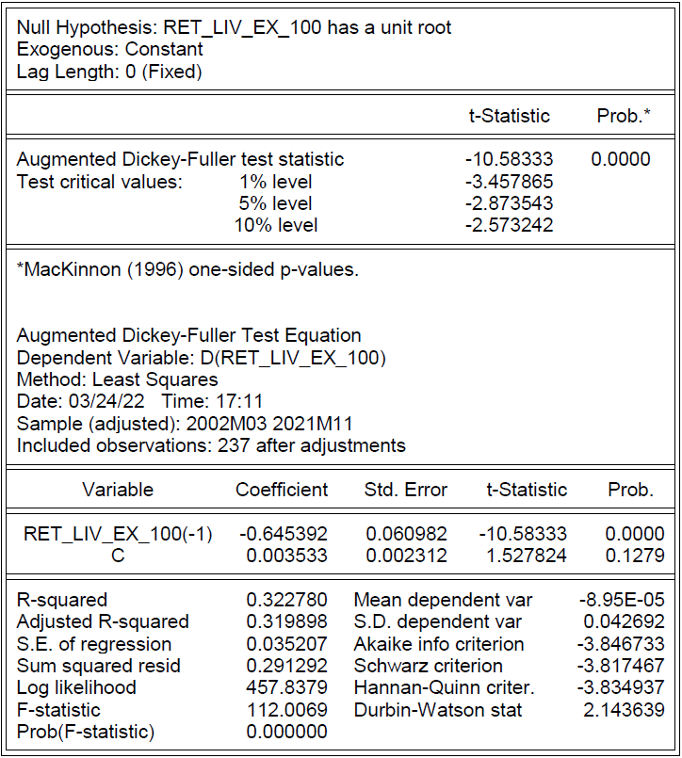
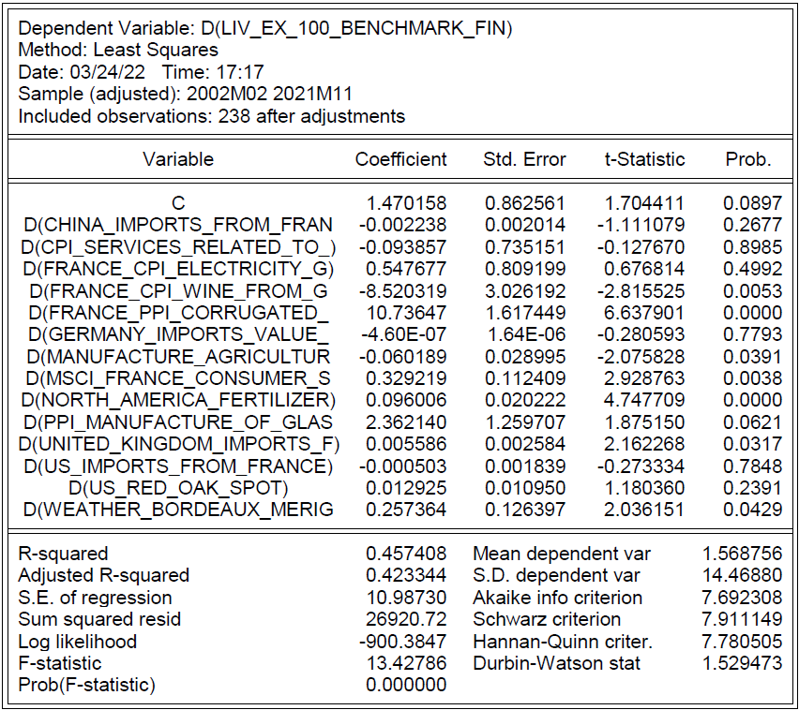
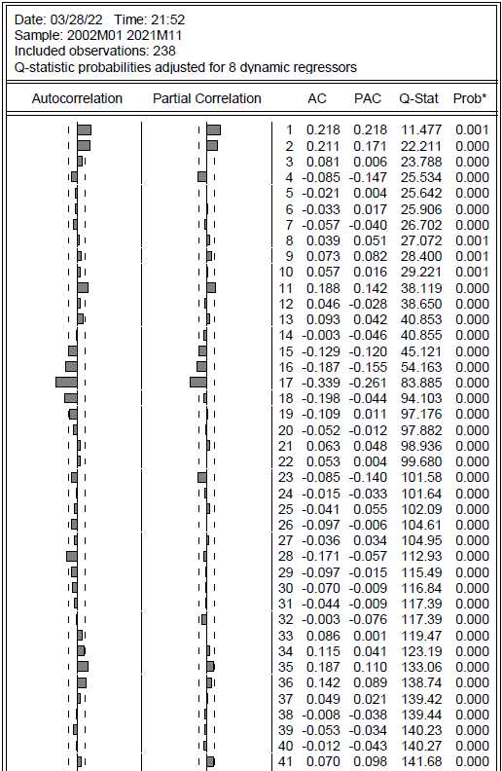
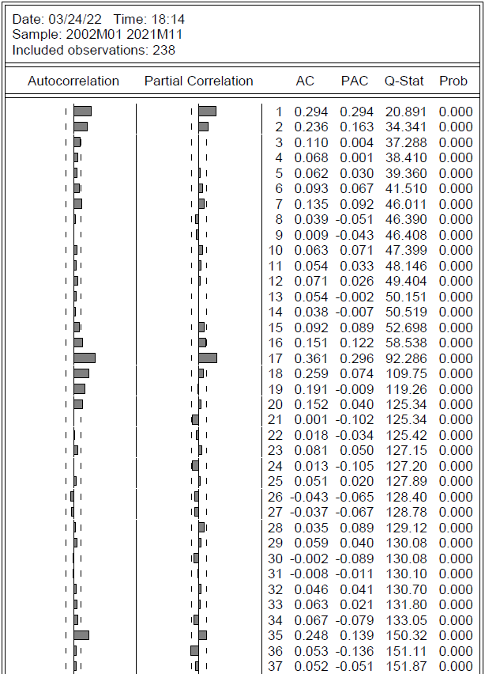
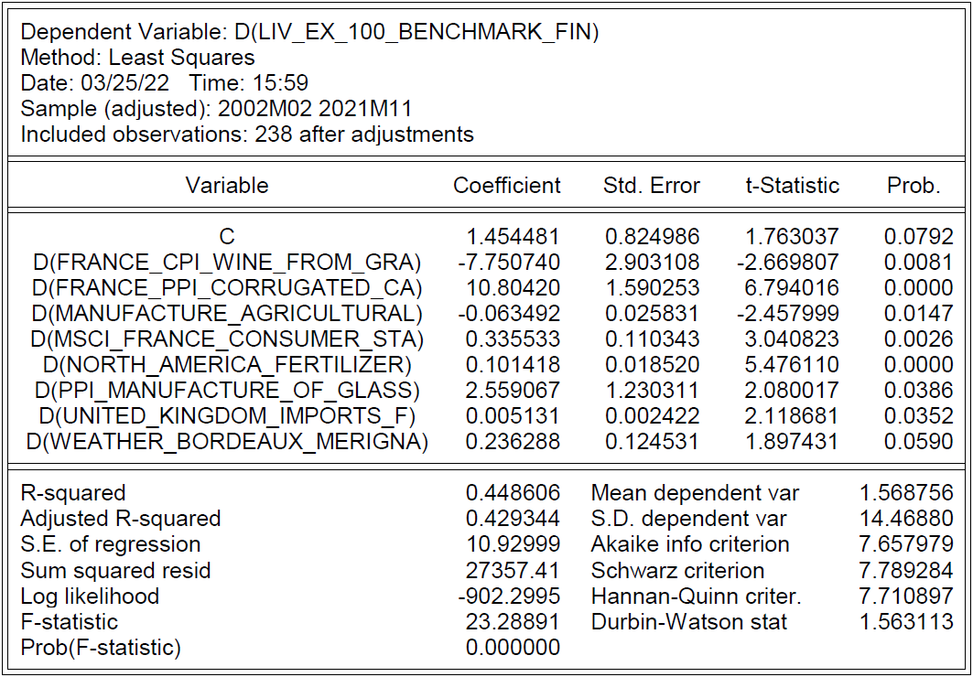
A. Investigation for trends, stationarity, seasonal and intervention effect (2/3)
A
B
• Then, we examine the partial correlation of the residuals (D) and squared residuals (E) of the statistically significant variables to examine which lags would be relevant to investigate.
• We notice that the lags 1, 2, 15, 16, 17, 35 and 36 are outside the PACF’s confidence intervals (highlighted in red) and worth investigating. This may indicate a seasonality effect.
D
…
E
• We observe that D(Liv Ex) is stationary (A) with a unit root test.
• We then want to investigate the relationship of D(Liv Ex) with the differences of the variables we mentioned.
• First, we run a linear regression with all these variables (B), and only keep those which are statistically significant (C). This model gives us an adjusted R-squared of 42.93.
C
…
…

Slide 4
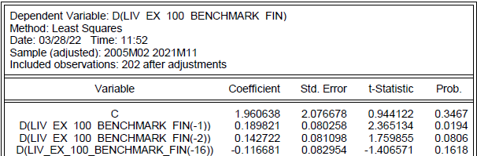
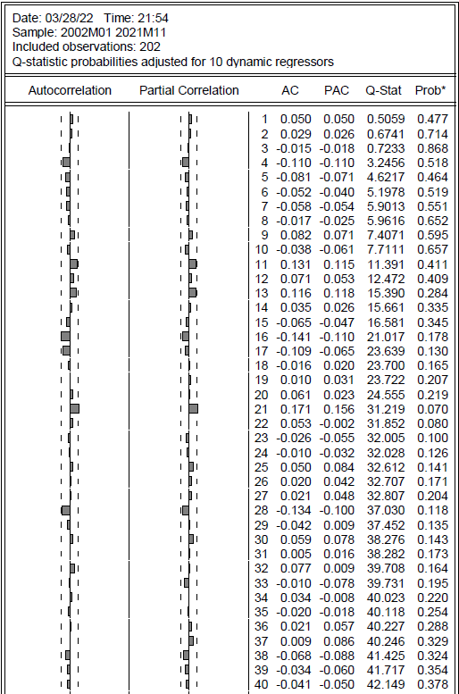
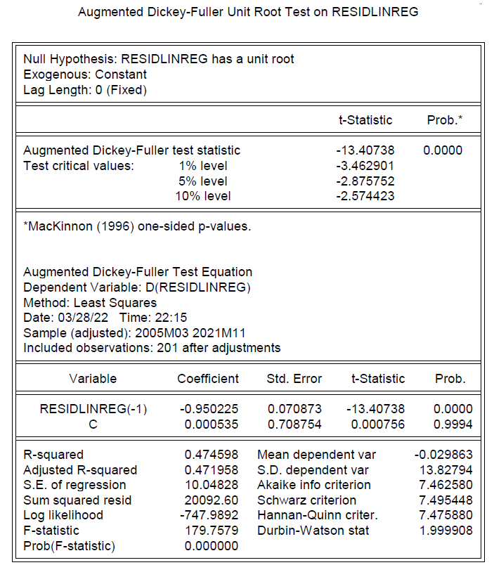
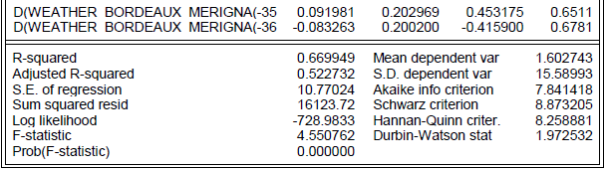
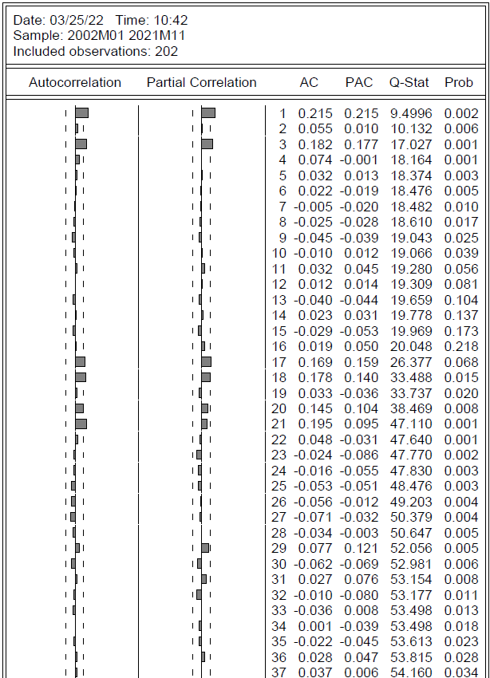
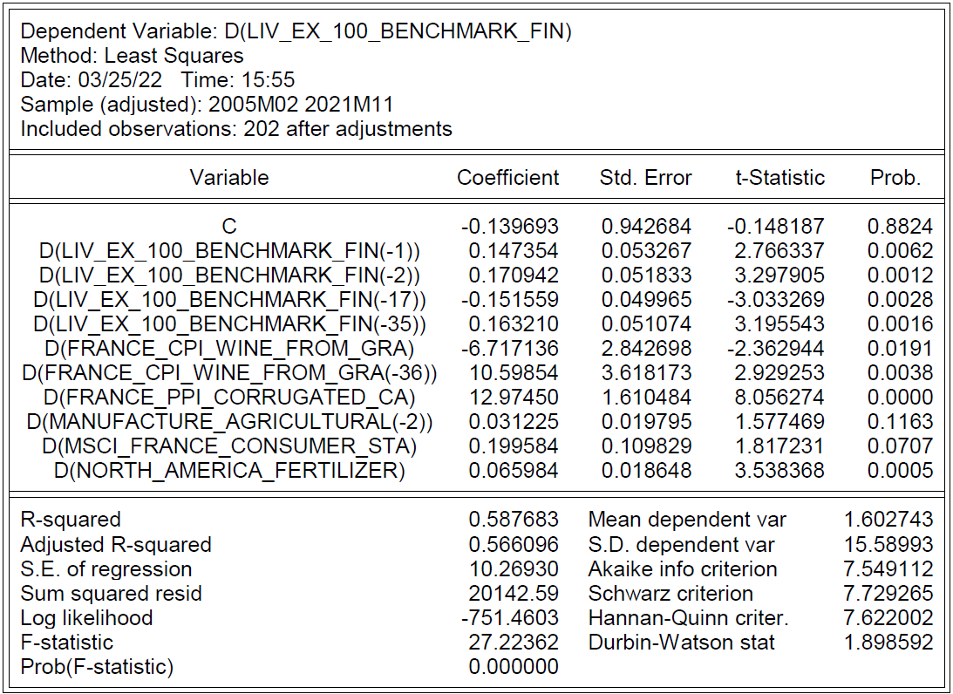
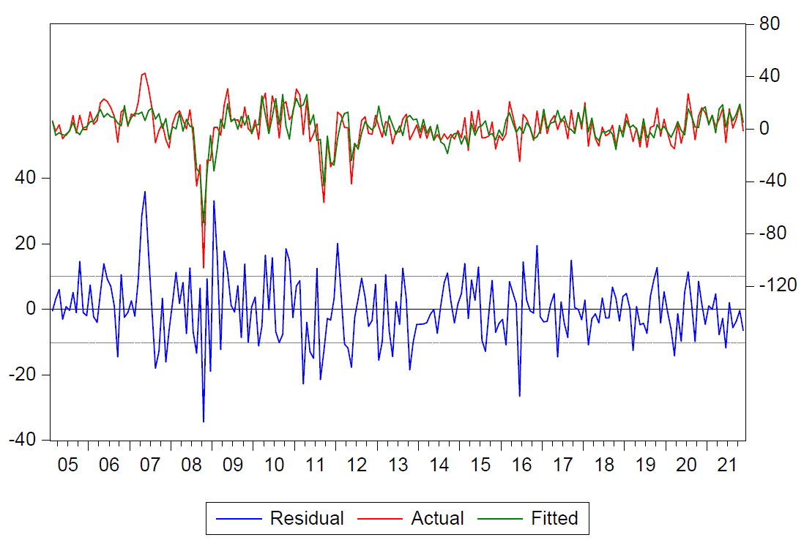
A. Investigation for trends, stationarity, seasonal and intervention effect (3/3)
A
• We run a new regression with all the significant variables and lags 1, 2, 15, 16, 17, 35 and 36 (A). We then remove one by one the statistically non-significant variables and obtain a model which yields us an adjusted R-squared of 56.61 with 10 variables (B).
• The PACF for this new regression gives us lags for residuals (C) and squared residuals (D) that are much more within the boundaries that the “unlagged” regression.
C
E
…
…
…
D
B
…
F
…
• The ADF of the residuals (E) shows that they are stationary, as can be seen on the residuals charts (F).

Slide 5
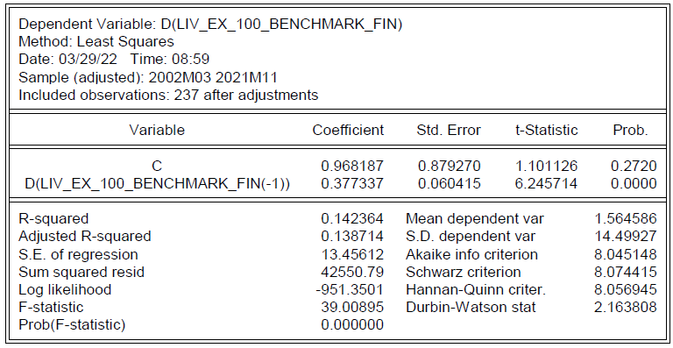
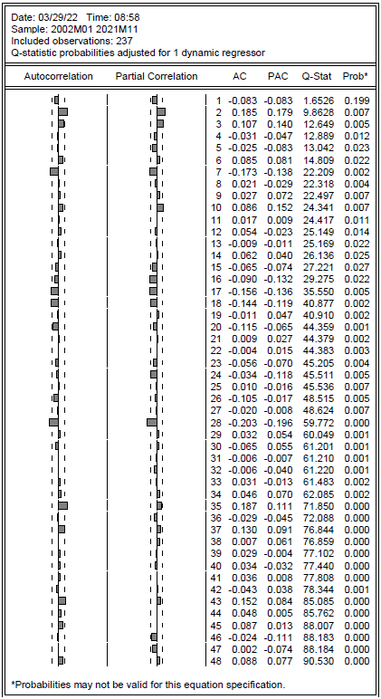
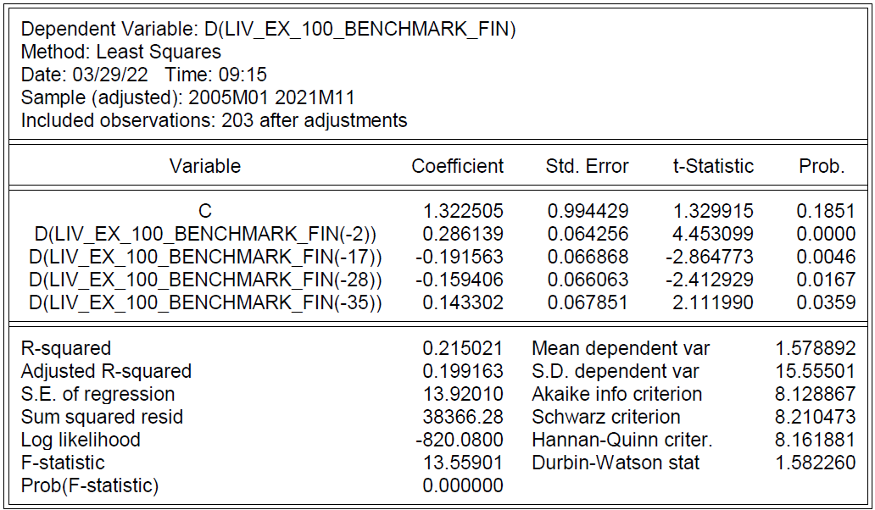
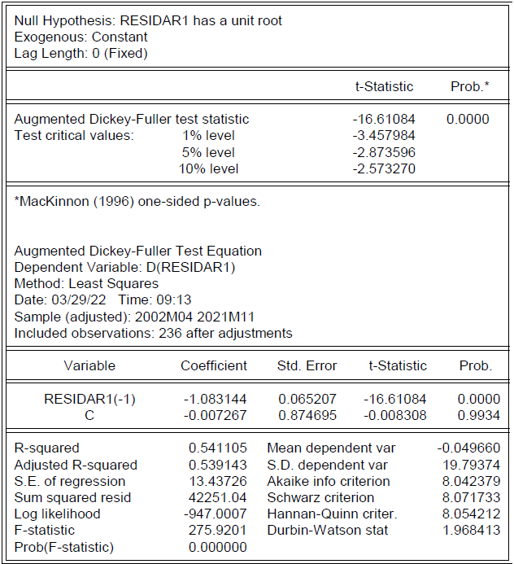
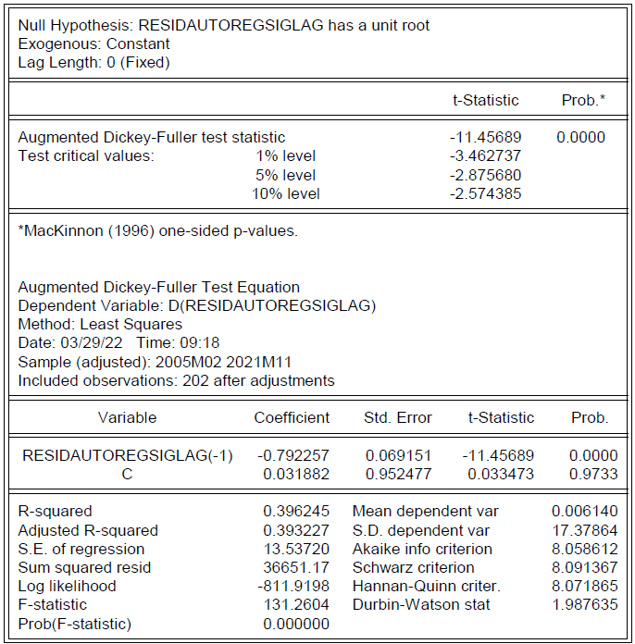
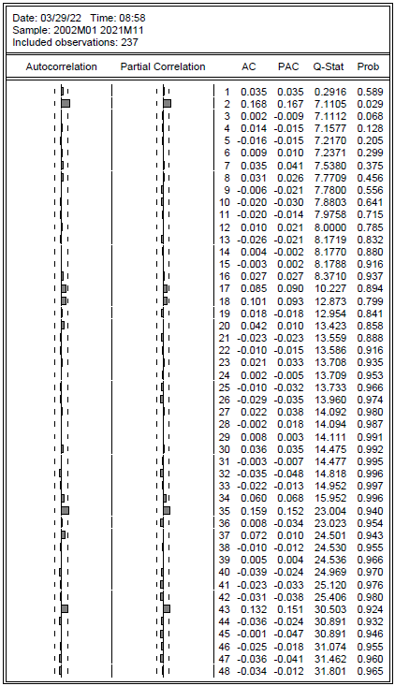
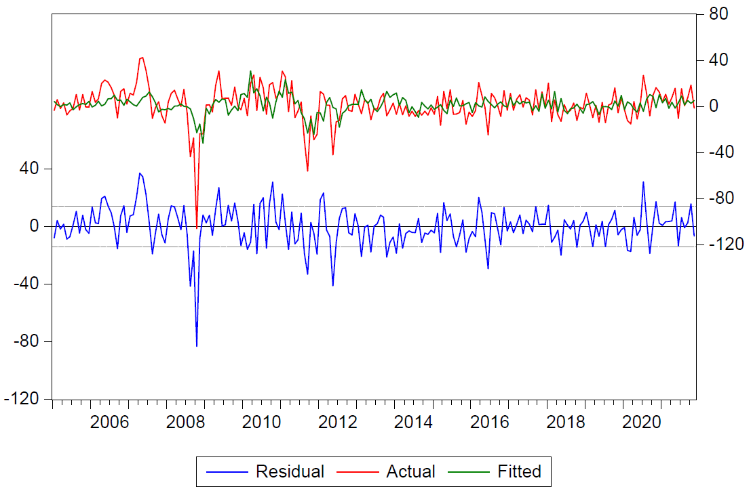
B. Investigation for autoregressive properties
A
C
E
…
…
…
F
B
• Running an AR1 (A), we obtain an adjusted R-squared of 13.87 and stationary residuals (B). The PACF for residuals (C) and squared residuals (D) leads us to examine the lags 2 3 7 10 16 17 28 and 35 (highlighted in red) .
D
G
…
• Regressing with these lags and removing one by one the significant variables yields us an adjusted R-squared of 19.92 (E) and stationary residuals (F and G).

Slide 6
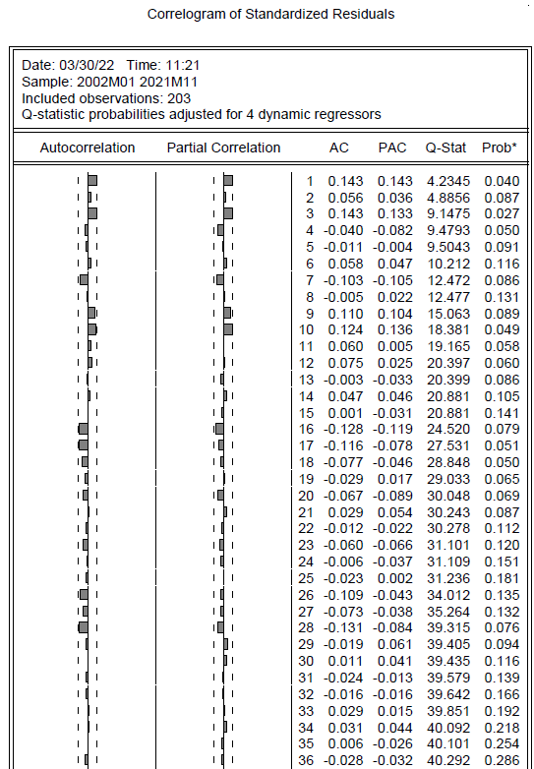
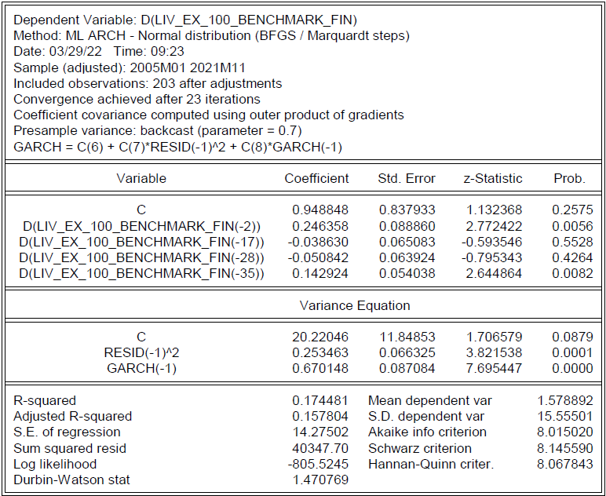
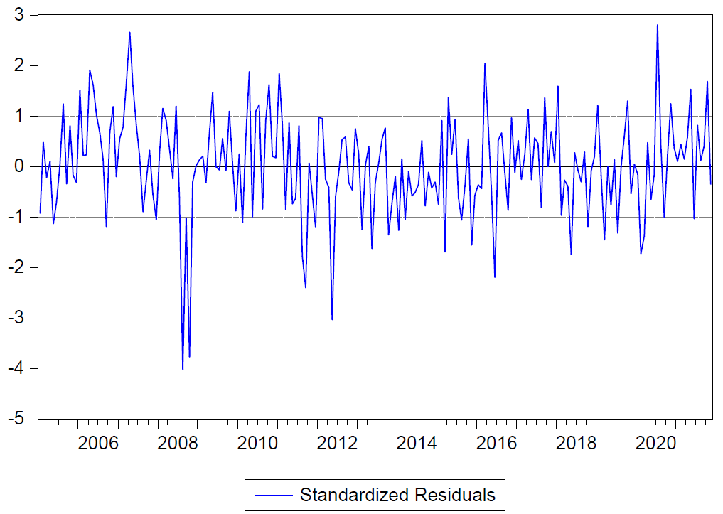
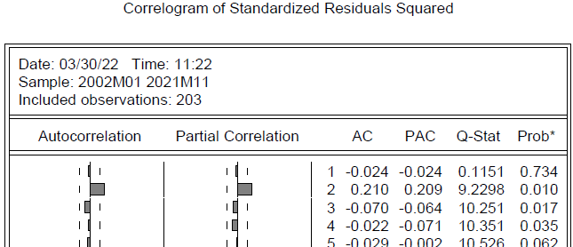
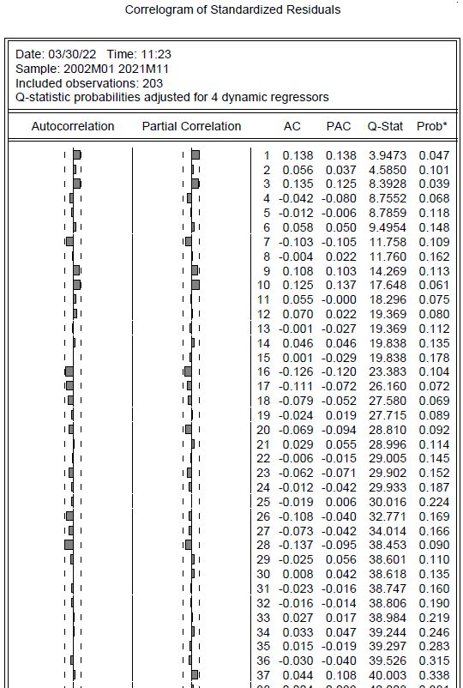
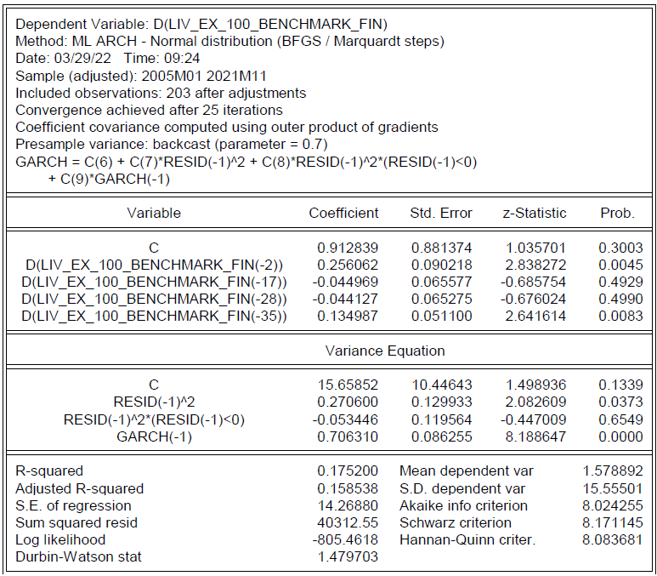
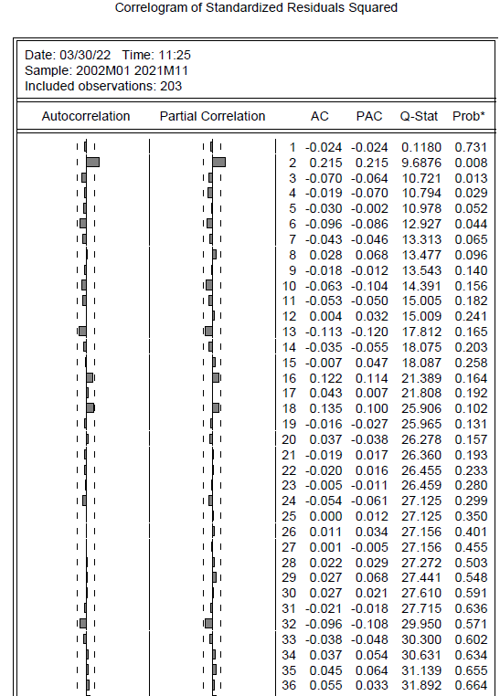
C. Investigation for conditional volatility properties
GARCH (1,1)
• Using a conditional volatility GARCH (1,1) (A) model and GARCH (1,1) model with a threshold (E) yield quite similar results.
• The PACF shows only one lag slightly outside the confidence interval (2) for squared residuals (C and G). The standardized results are stationary (D and H).
A
B
D
C
GARCH (1,1) w. threshold
E
F
H
G

Slide 7
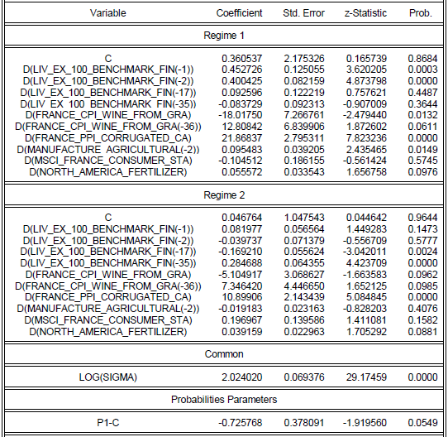
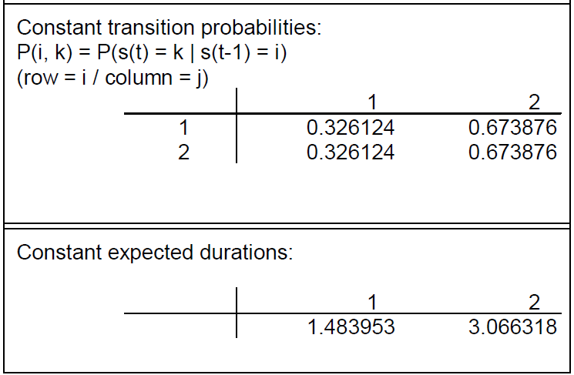
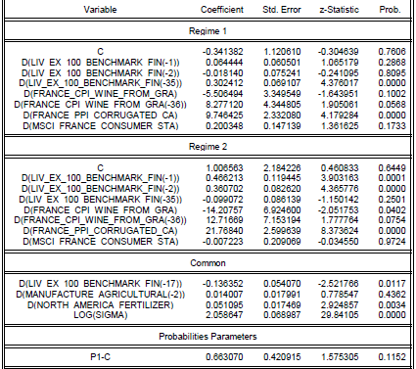
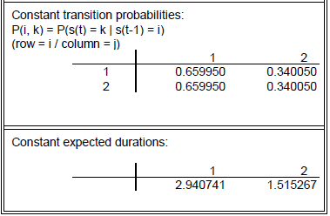
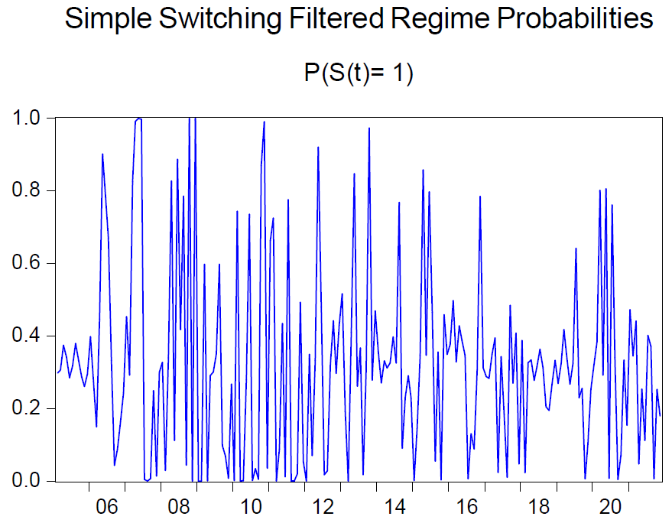
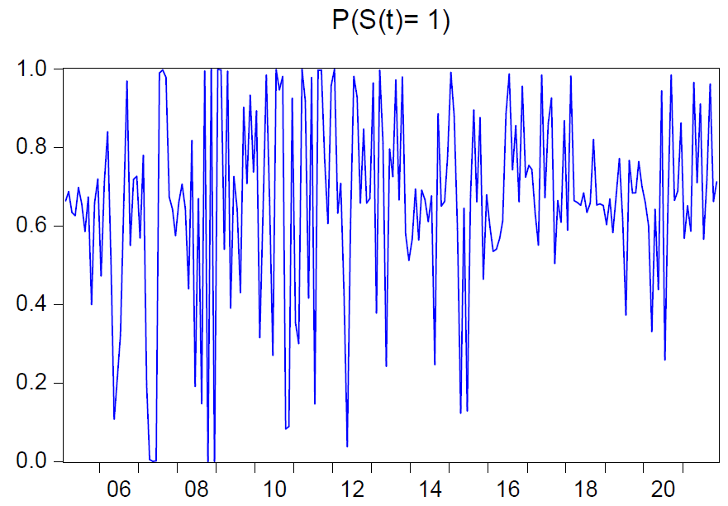
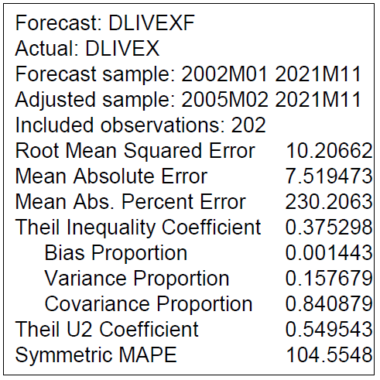
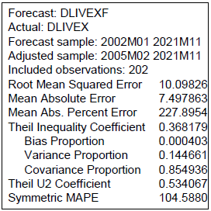
D. Investigation for regime switching properties (1/2)
E
A
C
G
H
D
B
• Creating a Markov 2-regime switching model (A) yields a MAPE of 104. 55 (B) with significantly different probabilities (C). The second model’s occurrence tends to increase as of 2014 (D).
• Putting as common variables (E) those whose difference is les than 0.3 (F) between the two models, we obtain quite similar MAPE (I) and switching probabilities (G and H).
F
Variable | T-Stat diff
D(LIV_EX_100_BENCHMARK_FIN(-1)) | 0.371
D(LIV_EX_100_BENCHMARK_FIN(-2)) | 0.440
D(LIV_EX_100_BENCHMARK_FIN(-17)) | 0.262
D(LIV_EX_100_BENCHMARK_FIN(-35)) | 0.368
D(FRANCE_CPI_WINE_FROM_GRA) | 12.913
D(FRANCE_CPI_WINE_FROM_GRA(-36)) | 5.462
D(FRANCE_PPI_CORRUGATED_CA) | 10.969
D(MANUFACTURE_AGRICULTURAL(-2)) | 0.115
D(MSCI_FRANCE_CONSUMER_STA) | 0.301
D(NORTH_AMERICA_FERTILIZER) | 0.016
I

Slide 8
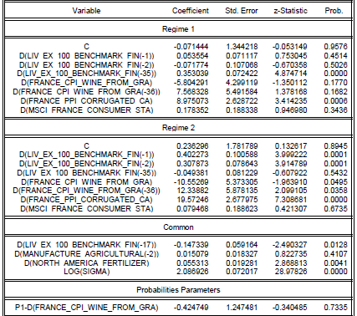
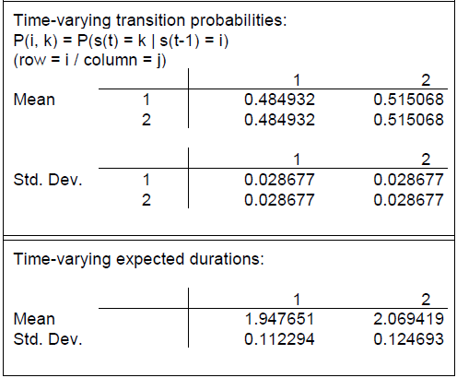
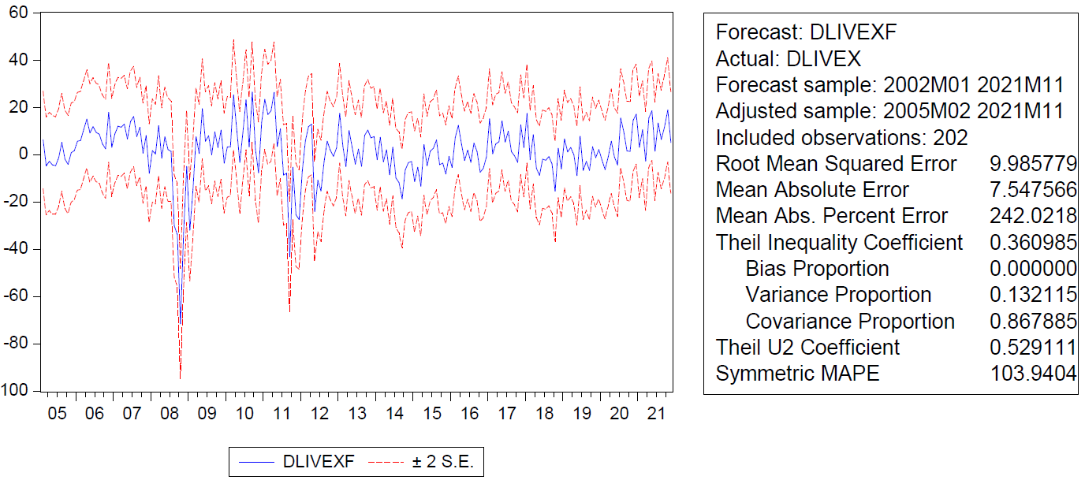
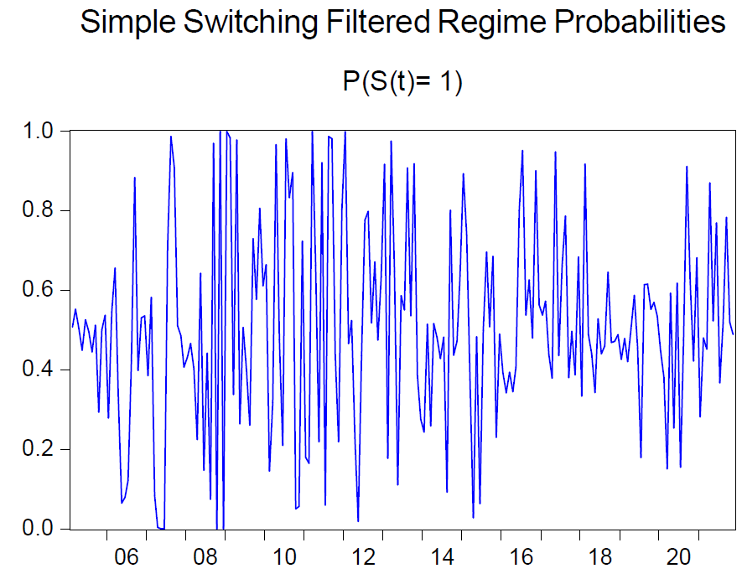
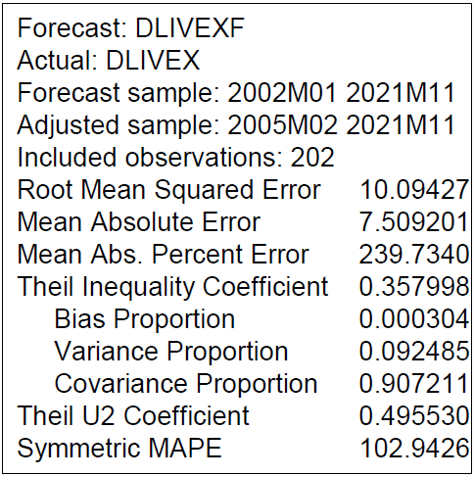
D. Investigation for regime switching properties (2/2)
A
C
E
D
• We see that the MAPEs we obtained with our variations of Markov 2-regime switching models are very close to the MAPE of 103.94 obtained with our linear regression with significant lags (E) we obtained in slide 4 – B.
• Hence, we do not think that using a regime switching model to forecast the evolution of the Liv-ex index is the most relevant approach.
B
• Putting the CPI of wines from grapes as a regressor on top of the common variables (A), we obtain a slightly lower MAPE (B) but two models whose probabilities are very close (C and D).

Slide 9
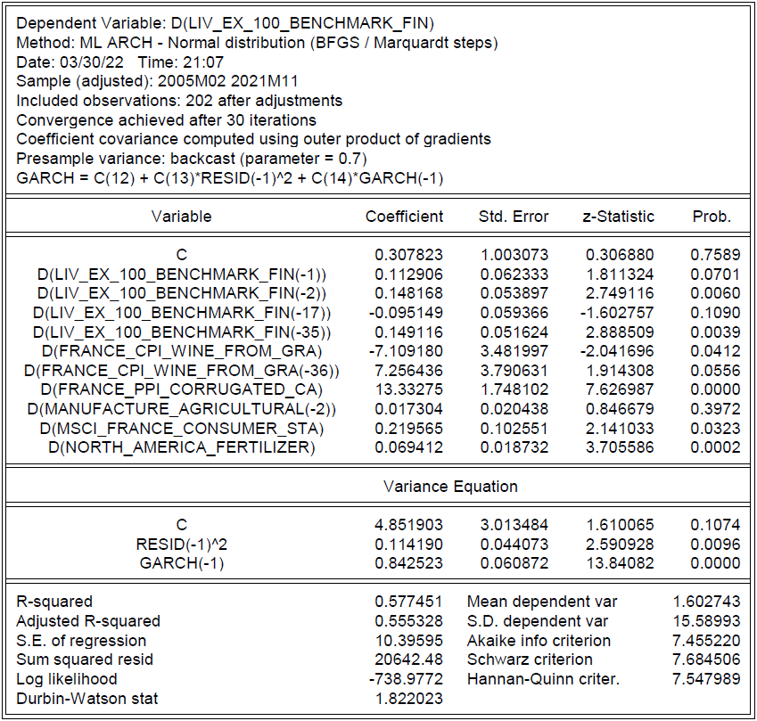
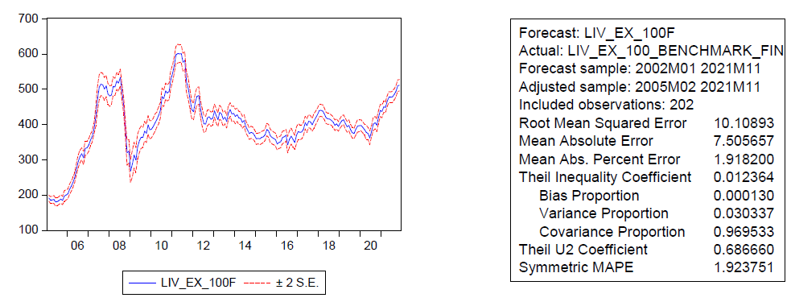
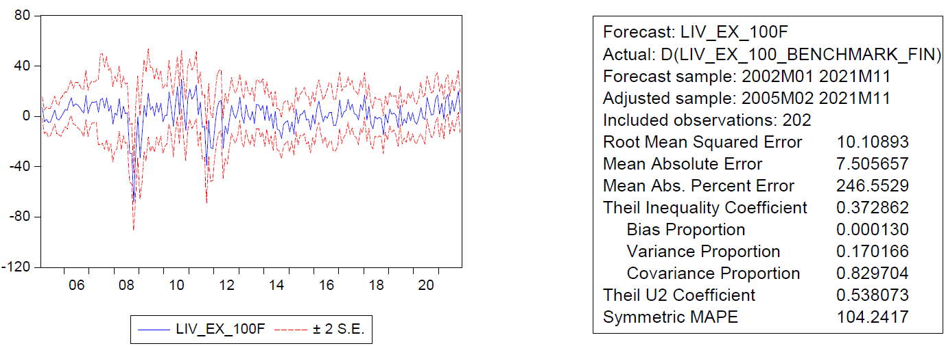
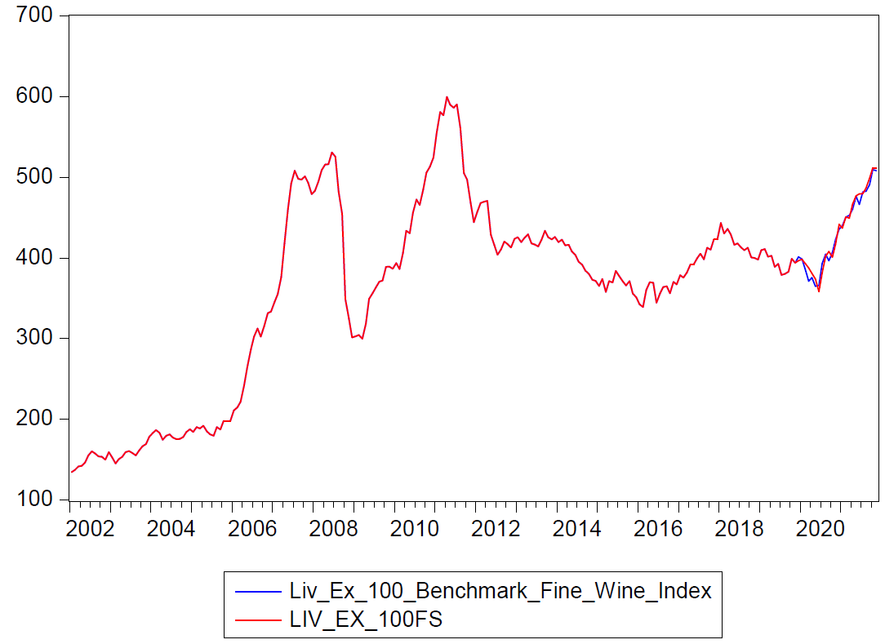
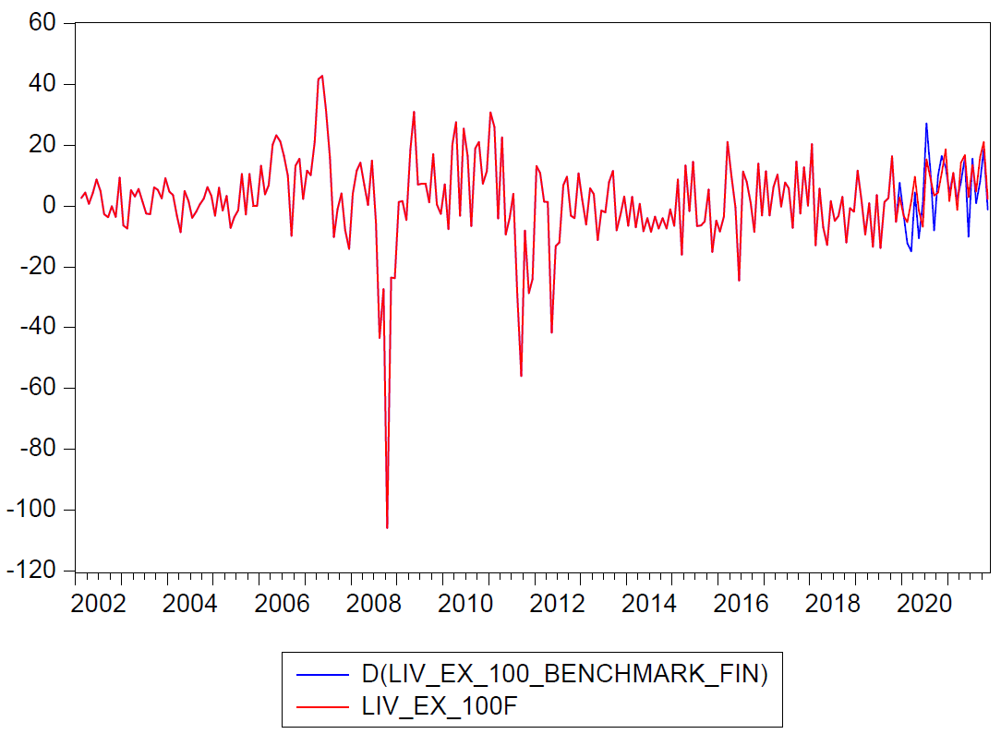
E. Specification and testing of a one step ahead predictive model for the mean
A
B
C
D
E
• Using the linear regression model we obtained in slide 4 – B and using a GARCH (1,1) model to better take into account the changing volatility (A), we obtain MAPE of 1.92 (B) and 104.24 (C) for respectively the index and the differences.
• Back testing with 90% of the data to forecast the remaining 10%, the model’s accuracy seems fair for both the index (D) and the differences (E).

Slide 10
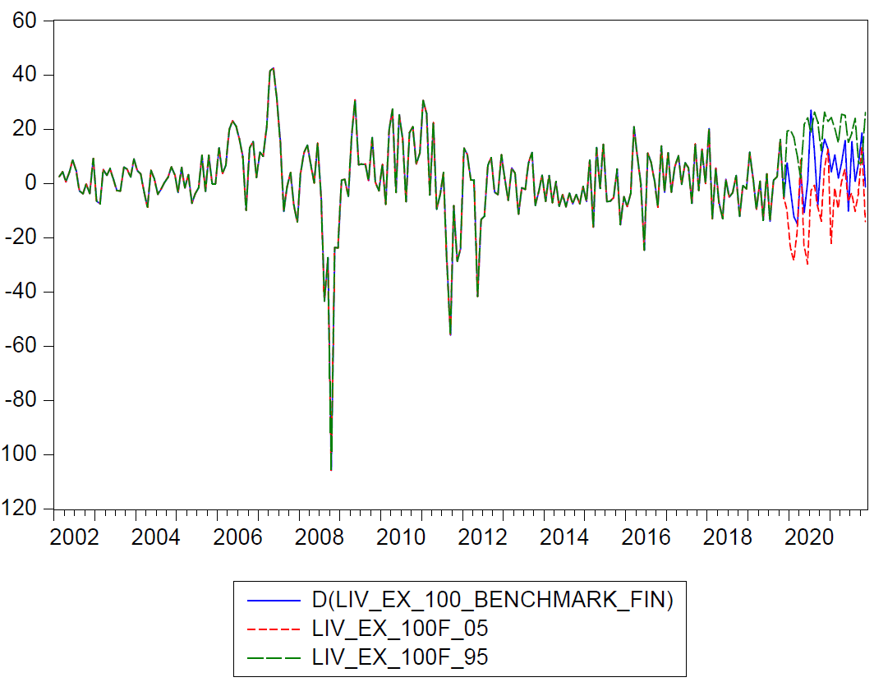
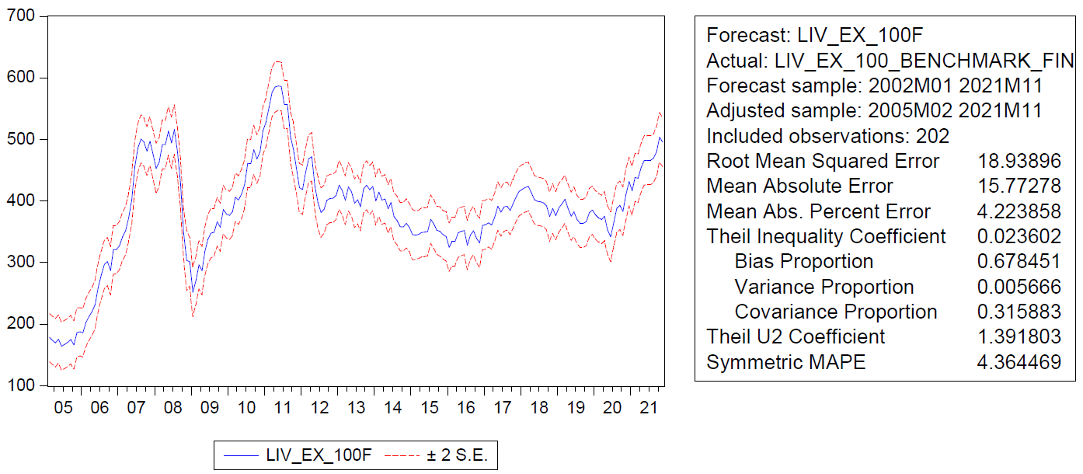
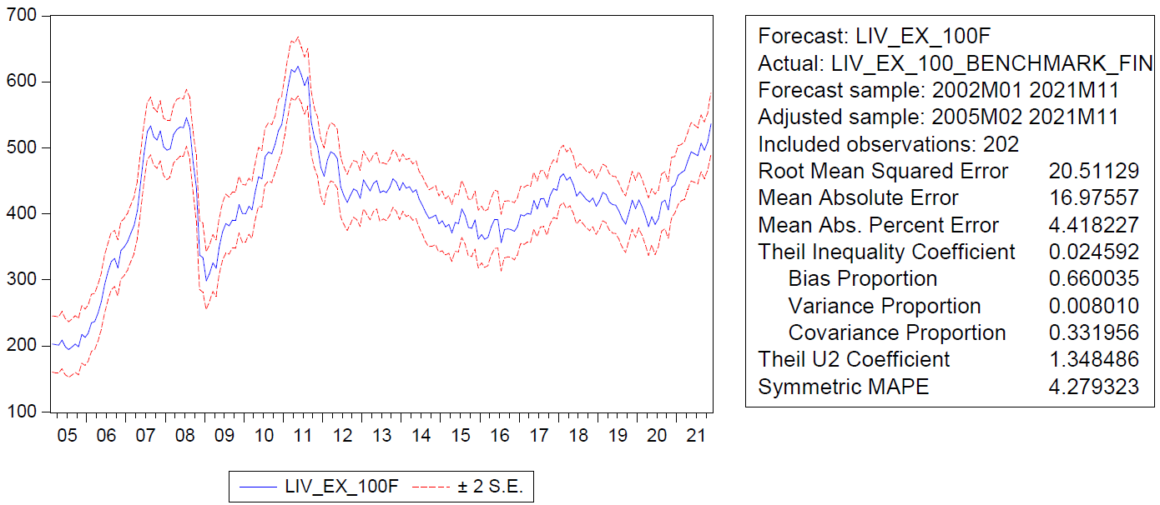
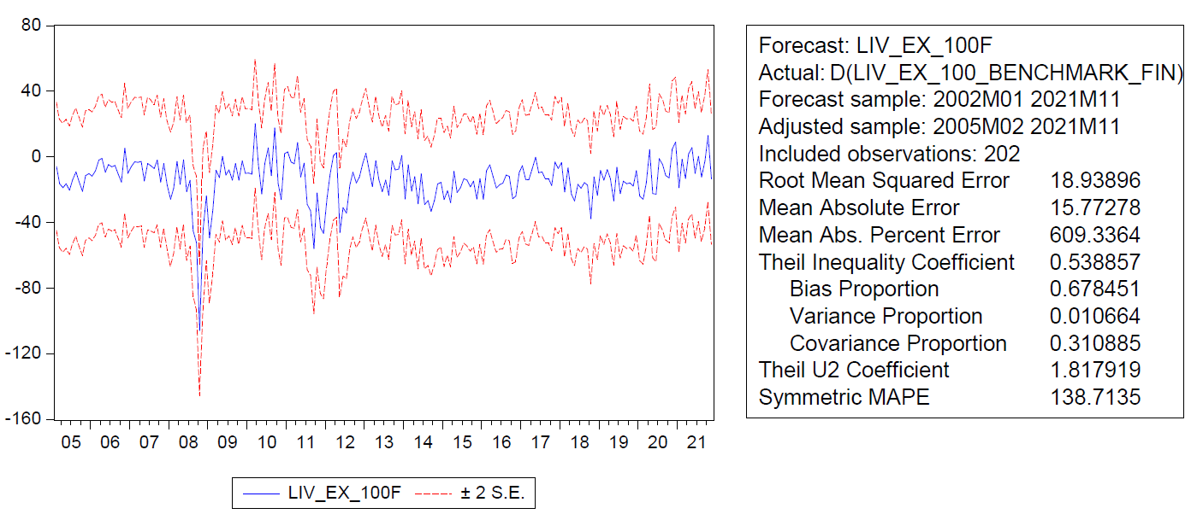


F. Specification and testing of a one step ahead predictive model for the P5 and P95 quantiles
5th quantile
95th quantile
E
A
C
B
D
F
• Still using the linear regression model we obtained in slide 4 – B , we obtain MAPEs of 4.36 (A) and 138.71 (B) for respectively the index and the index’s differences for the 5th quantile regression, and MAPEs of 4.28 (C) and 130.60 (D) for respectively the index and the index’s differences for the 95th quantile regression.
• Back testing in the same fashion for the quantiles, we see that the actual data fits well between the boundaries of the 5th and 95th quantiles for both the differences (E) and the index (F).

